Slide 1

Upper Limb Biomechanics
PT4054 / PT7001
Paul Starrs
p.starrs@londonmet.ac.uk

Slide 2
Overview
Explain how anatomical structure affects movement capabilities of upper-limb joints – shoulder, elbow, wrist and hand
Identify factors influencing the relative mobility and stability of upper-limb joints
Identify joint actions and nature of muscle activities occurring during specific upper-extremity movements such as reaching, grasping, throwing, catching etc
Describe the biomechanical contributions to common injuries of the upper limb joints

Slide 3
Overview
Recap what biomechanics is
Discuss functional upper limb anatomy in relation to biomechanics
Discuss the biomechanics of common overhead movements
Discuss common upper limb injuries heavily influenced by biomechanics

Slide 4
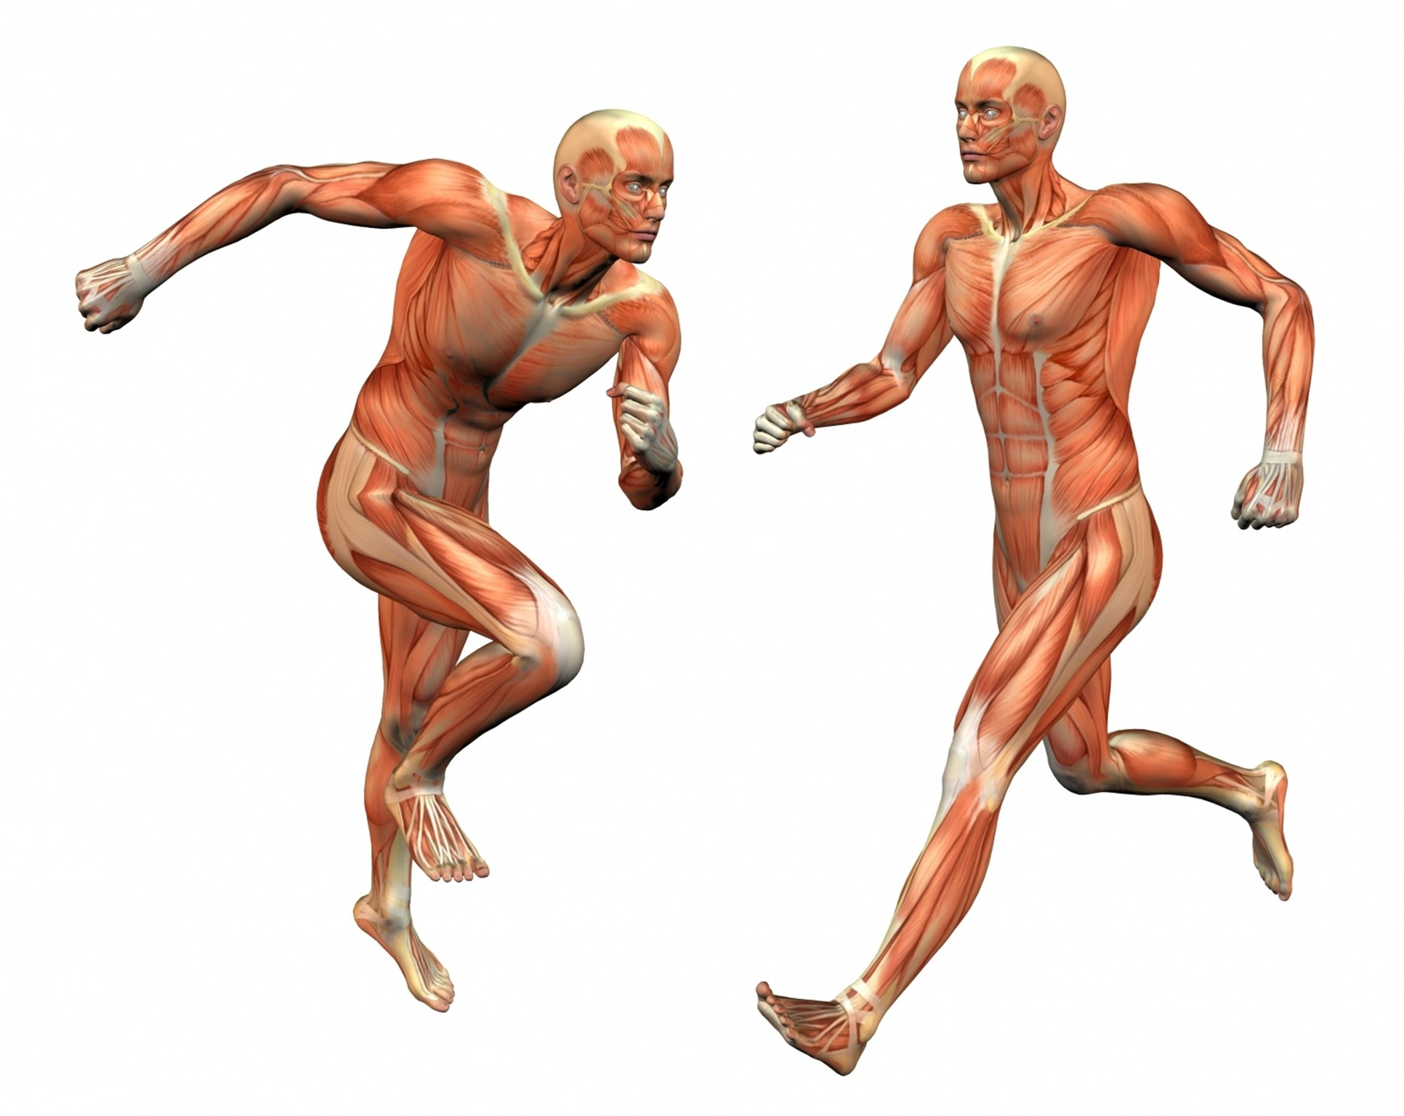
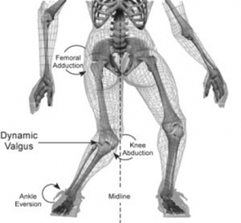
Any living thing
How trees grow
Cardiovascular system
What is biomechanics?
Musculoskeletal system & its relationship to movement
The science that involves the study of biological systems in a mechanical sense (Hatze, 1974)
BIO
MECHANICS
Prefix for life or living organism
Study of motion, forces, response of materials
Motion = movement
Forces = the factors that cause movement
Response = bending, compression, stretching, etc.
Notes:
The analysis of the action of forces on particles and mechanical systems
We are interested in the application of human biomechanics to sport

Slide 5
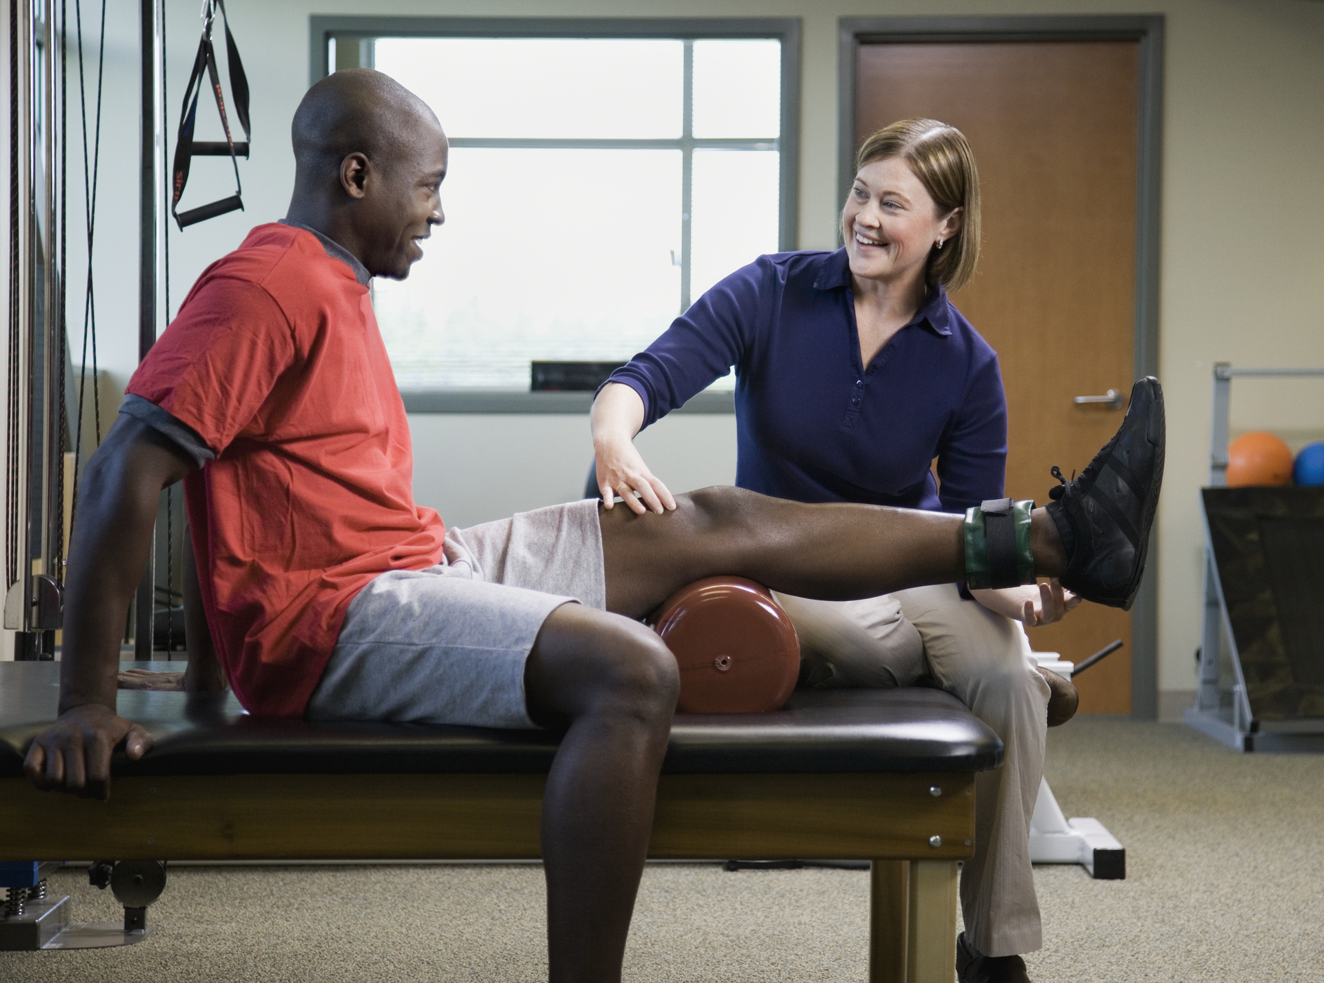
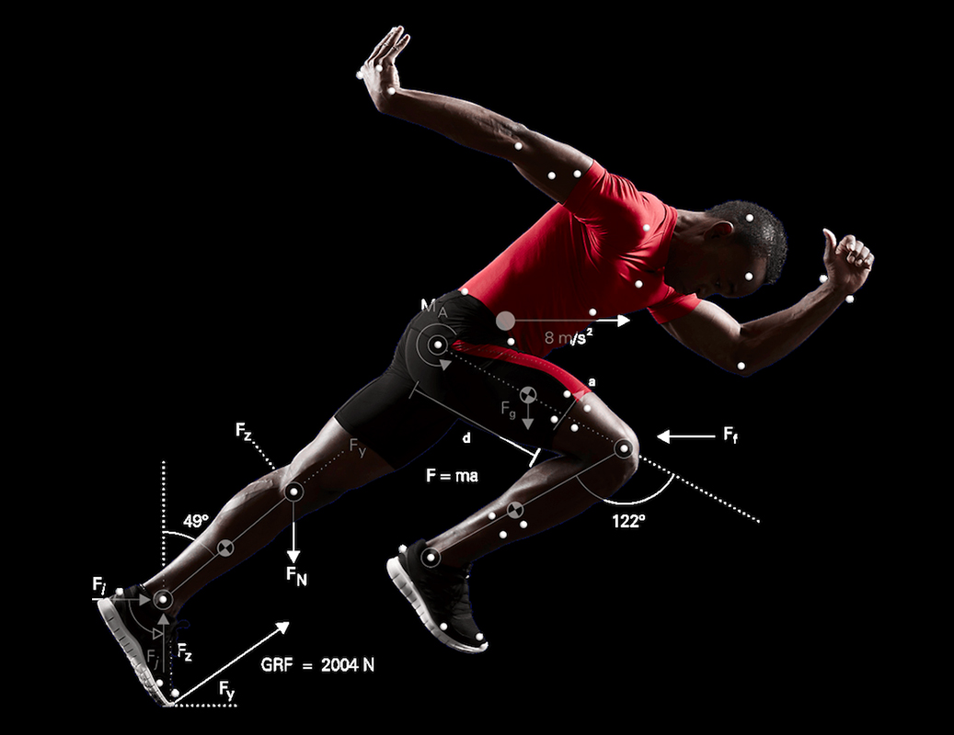
What is biomechanics used for?
Improving sports performance
Improving physical function
Occupational injury prevention (ergonomics)
Injury rehabilitation & prevention
Maintaining musculoskeletal health
Product design e.g. prosthetics and ergonomic tools
Forensic biomechanics

Slide 6
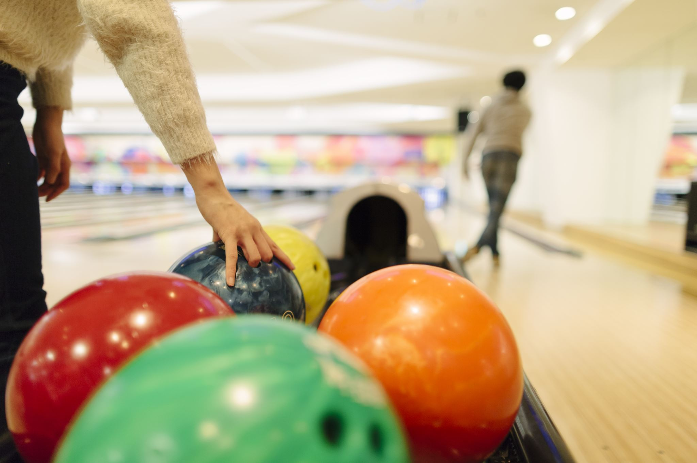
Elements of biomechanics
Kinematics – study of motion (excluding forces)
Kinetics – study of forces that cause of motion

Slide 7

Question time

Slide 8
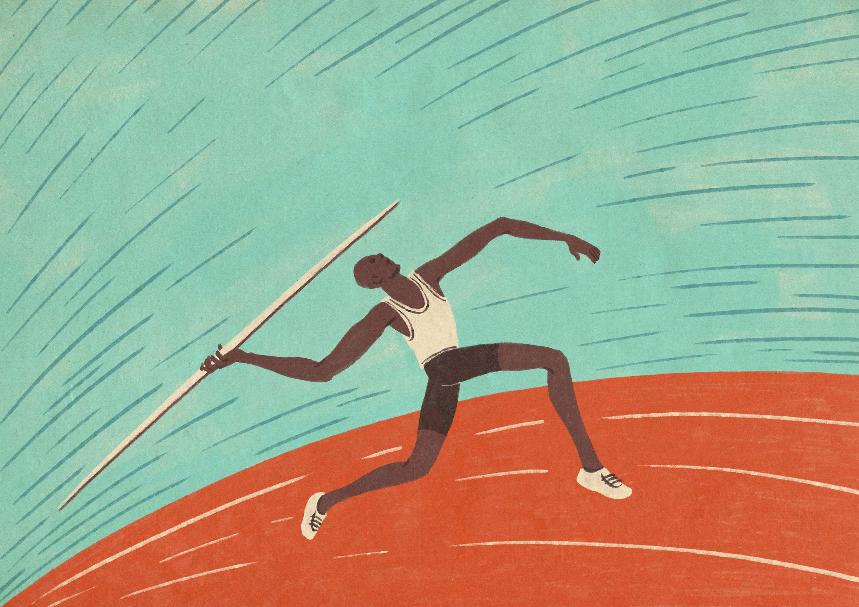
Kinetic chain
A biomechanical model which depicts the body as a whole linked system of independent segments to import a desired action at a distal segment (McMullen & Uhi, 2000)
Notes:
GIVE EXAMPLES

Slide 9
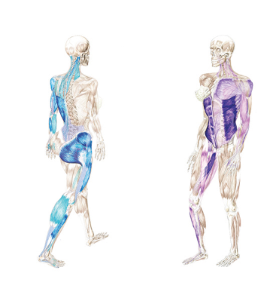
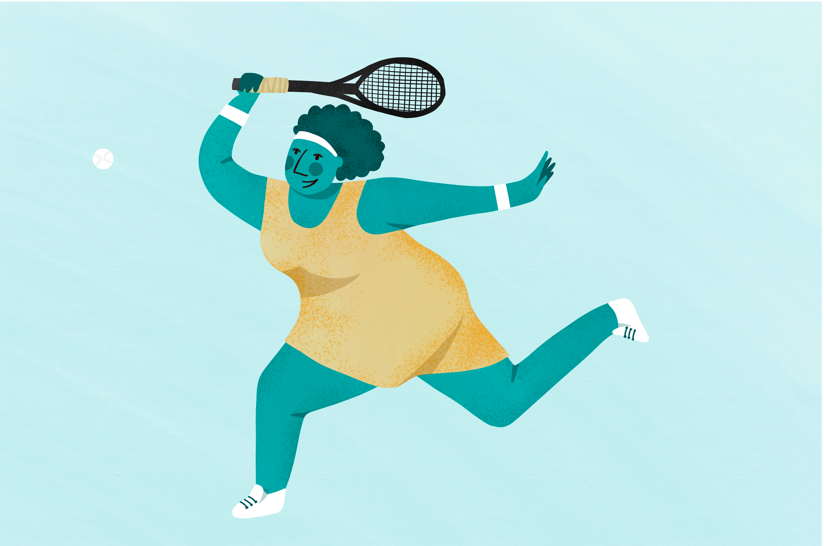
Anatomical slings
Notes:
GIVE EXAMPLES

Slide 10
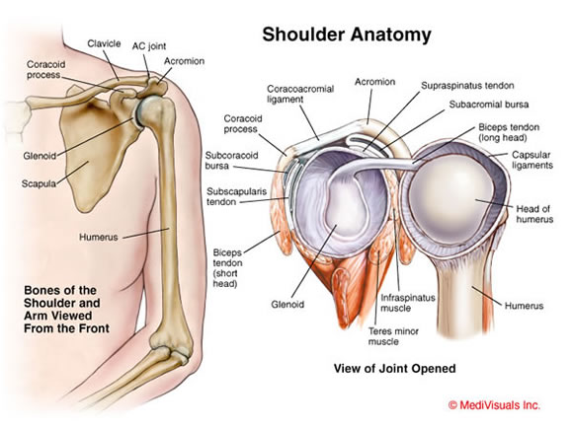
Functional shoulder anatomy
Shoulder complex consists of the;
  Glenohumeral (GHJ)
  Acromioclavicular (ACJ)
  Sternoclavicular (SCJ)
  Scapulothoracic joints
Only true articulation with the axial skeleton is via SCJ
Large mobility (ball & socket) predisposes to injury due to inherent instability
Notes:
GIVE EXAMPLES

Slide 11
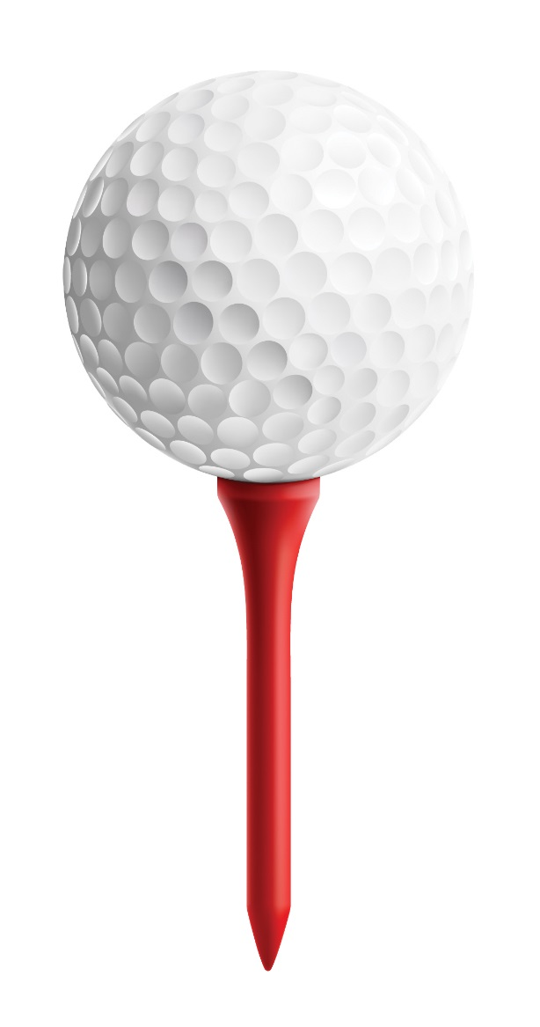
Functional shoulder anatomy
Passive
Active
Vacuum (intra-articular pressure)
Bony geometry
Labrum
Ligaments
Capsule
Proprioception (mechanoreceptors)
Muscles (local and global)
Notes:
GIVE EXAMPLES

Slide 12
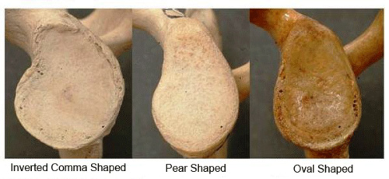
JRF = Joint reaction force
RC = Rotator cuff
SAC = Surface area contact
CLPM = Capsular ligamentous proprioceptive mechanism
NS = Nervous system
Shoulder stability simplified(?)
Everyone has one but function can vary
Can be damaged via degeneration or trauma
JRF = RC + SAC + CLPM + NS
Feedback / forward mechanism can vary
Limited congruency, can vary (Owens et al., 2013; Owens et al., 2014) and can be injured i.e. Bankart or Hill Sachs lesion
Notes:
Bankart – Glenoid
Hill-Sachs - Humerus

Slide 13
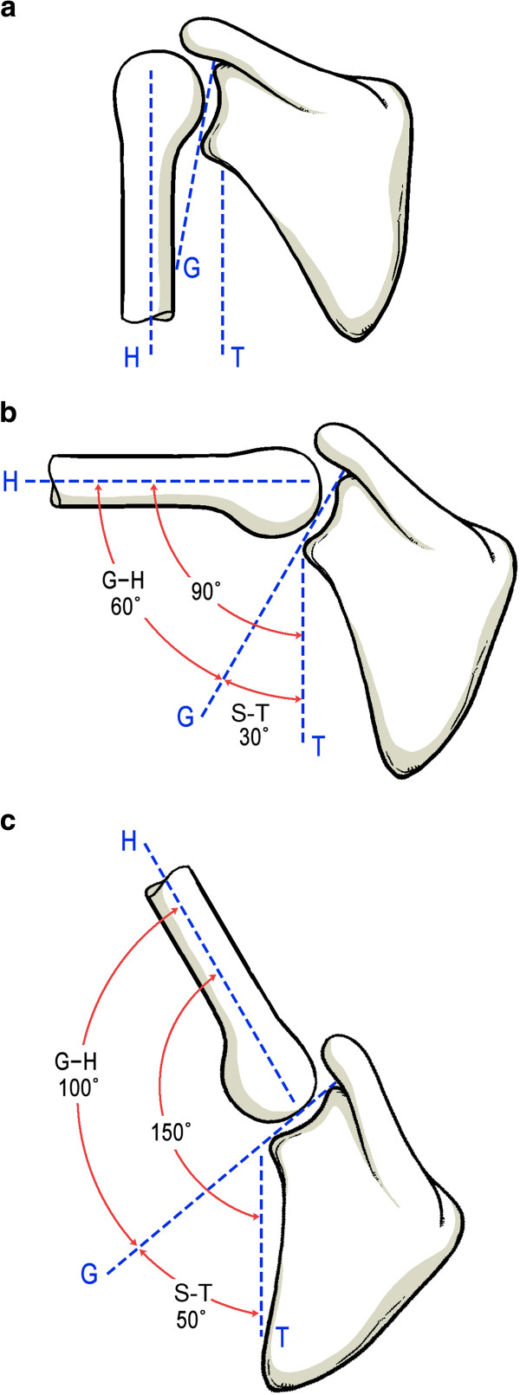
Scapulohumeral rhythm
Scapulohumeral rhythm is the coordinated motion of the scapula and humerus experienced during overhead shoulder movement
Traditionally viewed as occurring at a ratio of 2:1 (2 degrees of humeral flexion/abduction to 1 degree of scapular upward rotation)
Assess scapulothoracic movement
  Winging
  Thoracic movement
Notes:
GIVE EXAMPLES

Slide 14

Scapulohumeral rhythm
Notes:
GIVE EXAMPLES

Slide 15
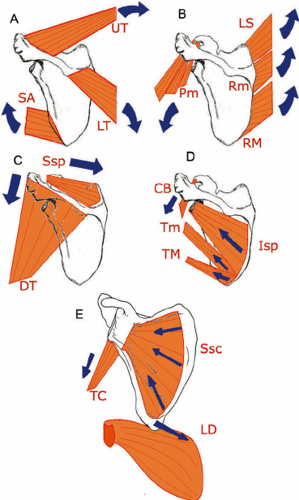
Scapular stabiliser muscle actions
For efficient scapulohumeral rhythm balance of strength and activation of muscles around the scapular is required
Struyf et al. (2014) found in 113 recreational overhead athletes that less scapular upward rotation at 45° and 90° of humeral abduction were significant for developing shoulder pain
Notes:
GIVE EXAMPLES

Slide 16
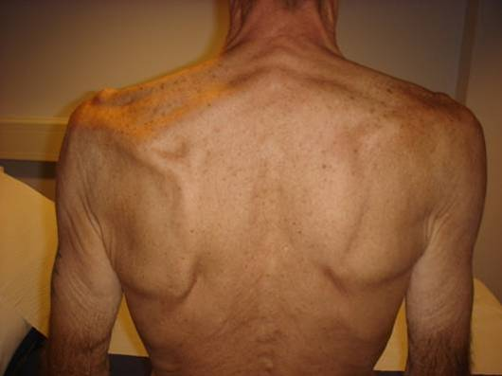
Notes:
GIVE EXAMPLES

Slide 17
Question time

Slide 18
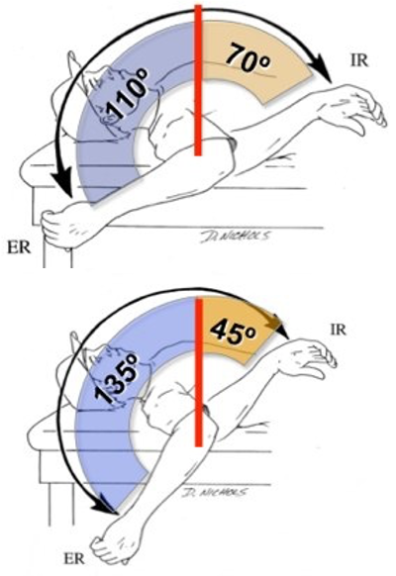
GIRD
Notes:
GIVE EXAMPLES

Slide 19

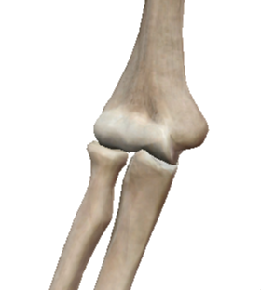
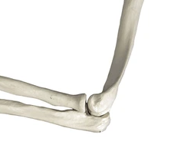
Articulations of the elbow joint
humerus
The three bones make up three joints of the elbow complex:
Humero-ulnar joint
Humero-radial joint
Superior radio-ulnar joint
Humero-radial joint
radius
ulna
radius
Superior radio-ulnar joint
ulna
Humero-ulnar joint

Slide 20
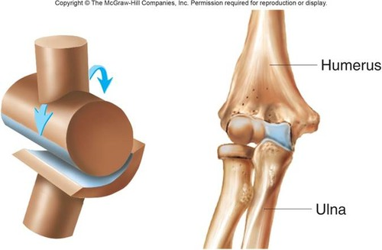
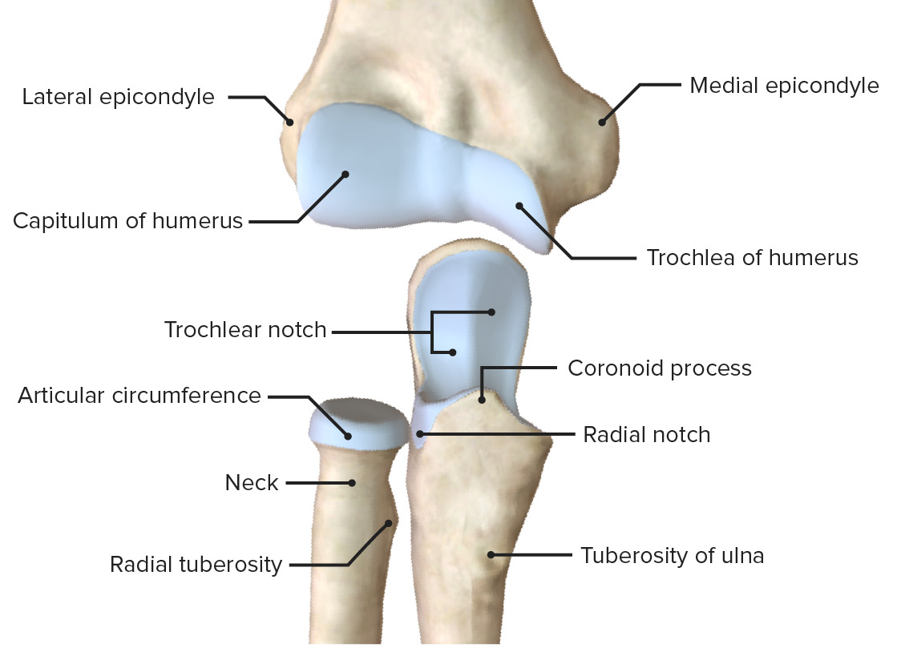
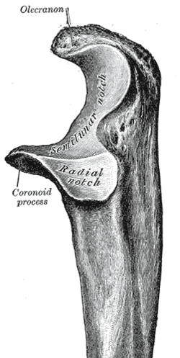
Elbow complex
Humeroulnar / humeroradial joint
Classification: synovial hinge joint (uni-axial)
Movements available: flexion / extension
Limited mobility but large amount of stability
Radial head

Slide 21
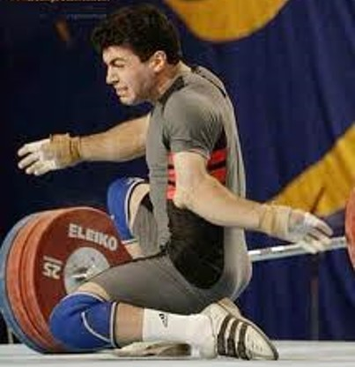
Elbow dislocation
Uncommon, but possible, with large amount of trauma
Requires reduction under anaesthetic and likely period of immobilisation
Once removed from immobilisation device, will be stiff+++
Be wary of neurovascular complications

Slide 22
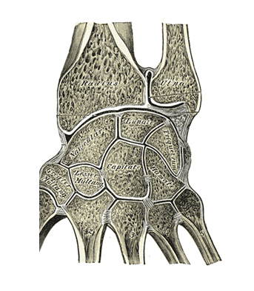
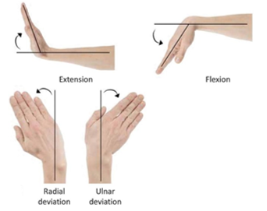
Radiocarpal joint
Compromised of the distal end of the radius (and ulnar) and the proximal row of carpals
Classification: synovial ellipsoidal / condyloid joint – bi-axial
Movements available: flexion / extension / radial and ulnar deviation

Slide 23
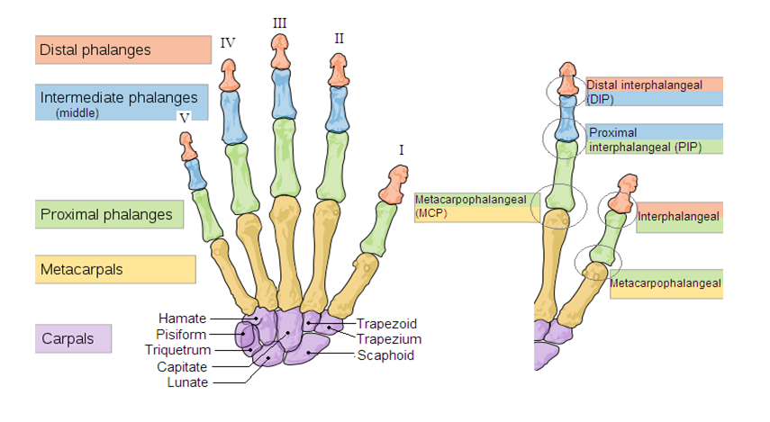
Hand
Exceptionally refined complex needed for grip and manipulation e.g. dressing, playing instruments, writing, typing, etc.
Balance of power and precision required, also, e.g. weight lifting, rock climbing, etc

Slide 24
Question time

Slide 25
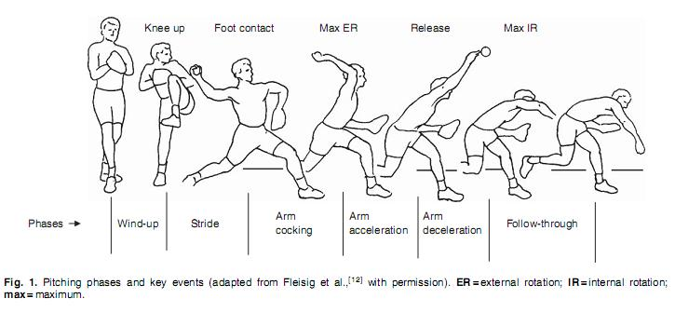
Throwing biomechanics
Asymmetric hip strength demonstrated increased risk of shoulder injuries in professional baseball pitchers (Plummer et al., 2023)
Notes:
GIVE EXAMPLES

Slide 26
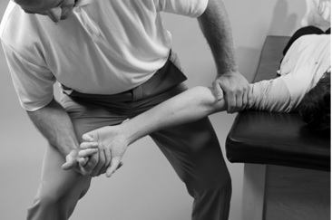
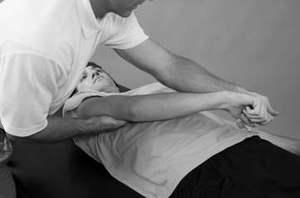
Movement patterns
D1 & D2
D1 and D2 movement patterns consider combined movements in all three plans of motion
D2 encompasses:
  A start position of carrying a tray, and,
  An end position of having thumb in opposite pocket
Notes:
GIVE EXAMPLES

Slide 27
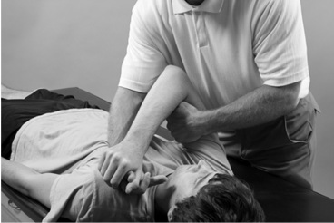
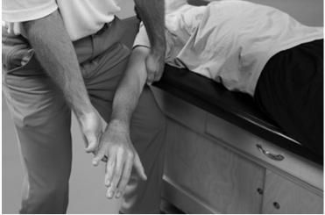
Movement patterns
D1 & D2
D1 and D2 movement patterns consider combined movements in all three plans of motion
D1 encompasses:
  A start position of swatting a fly, and
  An end position of holding hands
Notes:
GIVE EXAMPLES

Slide 28
Question time

Slide 29
Biomechanics and injuries
Kinematic chain deficiencies
  Poor shoulder stabilization forces excessive compensation at the elbow and wrist
  Weak core and hip control in overhead athletes alters throwing mechanics, increasing upper limb strain
Muscle imbalances and motor control deficits
  Overactive deltoid relative to rotator cuff leads to superior humeral translation (impingement risk)
Notes:
GIVE EXAMPLES

Slide 30
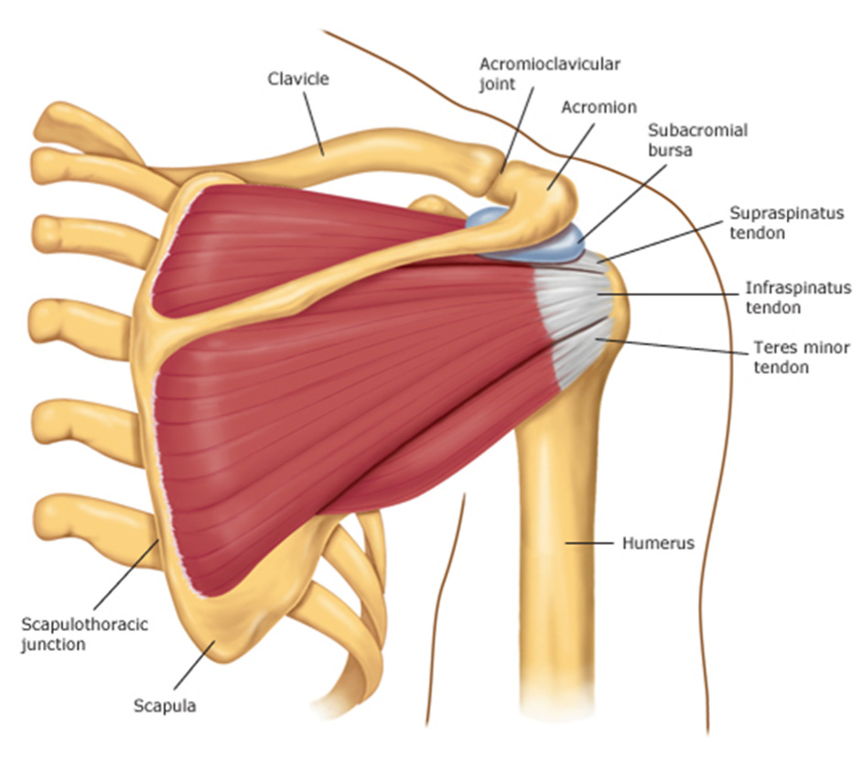
Biomechanics and shoulder injuries
Poor scapulohumeral rhythm (dyskinesis) alters the mechanics of overhead motion, reduces the subacromial space and increasing compression on the supraspinatus tendon and subacromial bursae
Either…
  Weakness or fatigue in the lower trapezius, serratus anterior, rhomboids, and/or,
  Imbalance between deltoid and rotator cuff muscles
…causes excessive superior migration of the humeral head during arm elevation, increasing compression and shear forces on the rotator cuff
Notes:
GIVE EXAMPLES

Slide 31
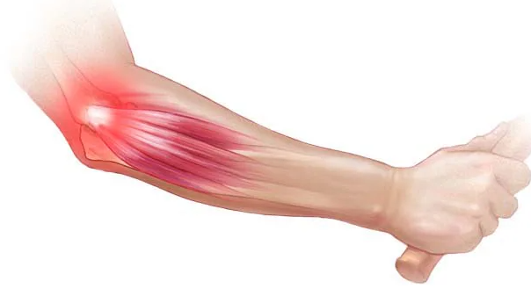
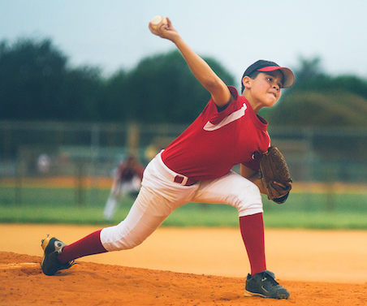
Biomechanics and elbow injuries
Epicondylitis (medial or lateral)
  Repetitive wrist extension / flexion and gripping activities lead to eccentric overload of the common extensor / flexor tendon origin
  Poor kinetic chain mechanics (e.g., weak stabilization at the shoulder) increase reliance on forearm muscles
  Improper grip mechanics during sports or work tasks increases strain on the tendons
Ulnar collateral ligament (UCL) sprain
  Excessive valgus stress during throwing motion causes progressive attenuation of the UCL
  Poor trunk and hip rotation mechanics in throwing leads to over-reliance on the arm
Notes:
GIVE EXAMPLES

Slide 32
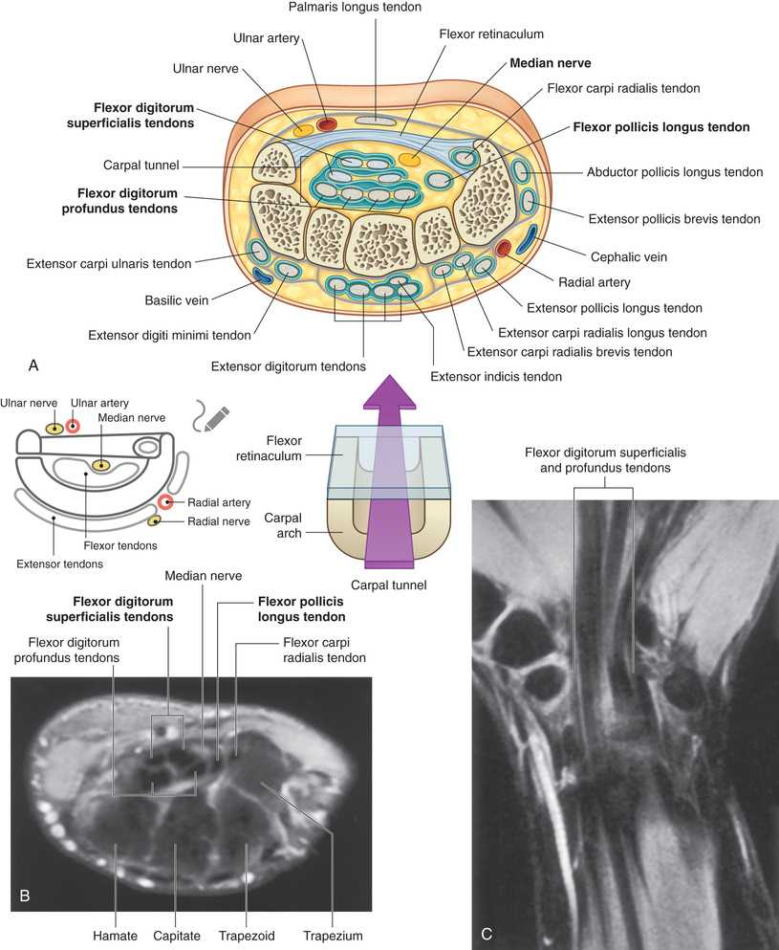
Biomechanics and wrist and hand injuries
Carpal tunnel syndrome
  Poor grip ergonomics or excessive finger flexor activity leads to hypertrophy of the flexor tendons, reducing available space in the tunnel
  Weak proximal shoulder stabilizers cause excessive reliance on wrist flexors for gripping tasks, contributing to repetitive strain, swelling and therefore space
Notes:
GIVE EXAMPLES

Slide 33
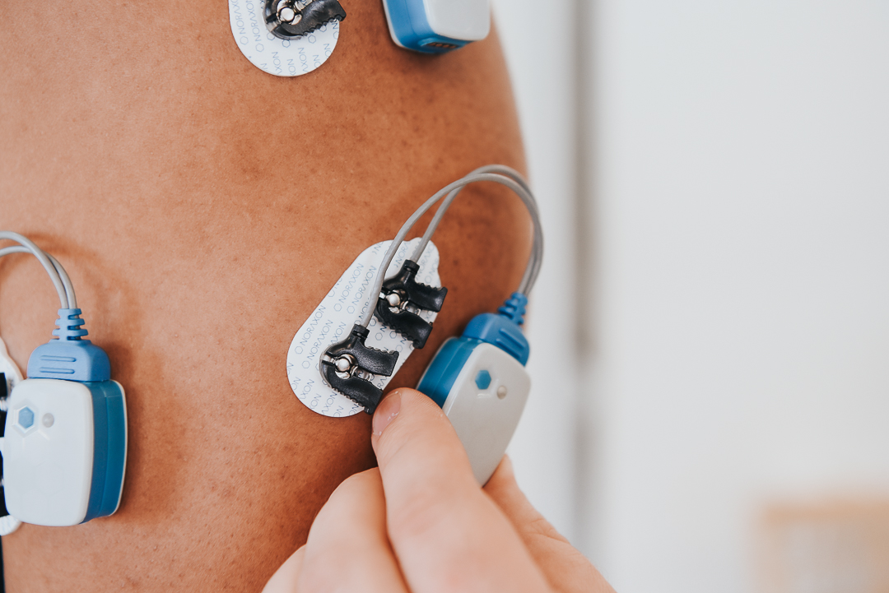
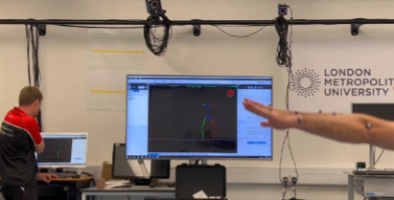
Tools for analysis
Video analysis
Motion capture
Electromyography (EMG)
Force platforms…
Notes:
GIVE EXAMPLES

Slide 34
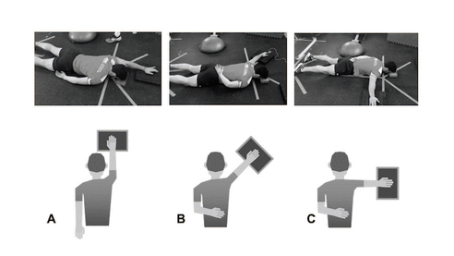
ASH test
The athletic shoulder (ASH) test is used to assess and monitor the shoulder isometric strength of athletes during recovery
It is a novel test developed by Ashworth et al. (2018) to evaluate the neuromuscular activity of the shoulder girdle in contact sports and those that includes overhead actions
Notes:
GIVE EXAMPLES

Slide 35
Summary
Biomechanics is the study of biological systems in a mechanical sense
The shoulder joint is highly reliant on active support to optimally function due to its inherent instability. This is offset by the elbow which is highly stable but with limited mobility
To be performed effectively overhead movements need kinetic chain contribution
Kinematic chain deficiencies, muscle imbalances and motor control deficits can cause injury due to the body following the path of least resistance

Slide 36
Question time

